Slide 1
Video Analysis with Using a Smartphone - Students as Active Learners
Becky Treu PhD
Moberly Area Community College

Slide 2
Students as Active Learners
One of the biggest issues in many mathematically-based disciplines is students making the connection between material covered in class and how it connects to real world applications.
In physics class students get the opportunity to directly see how mathematical process can be used to study motion and other phenomena
The best way for students to learn is through active participation

Slide 3
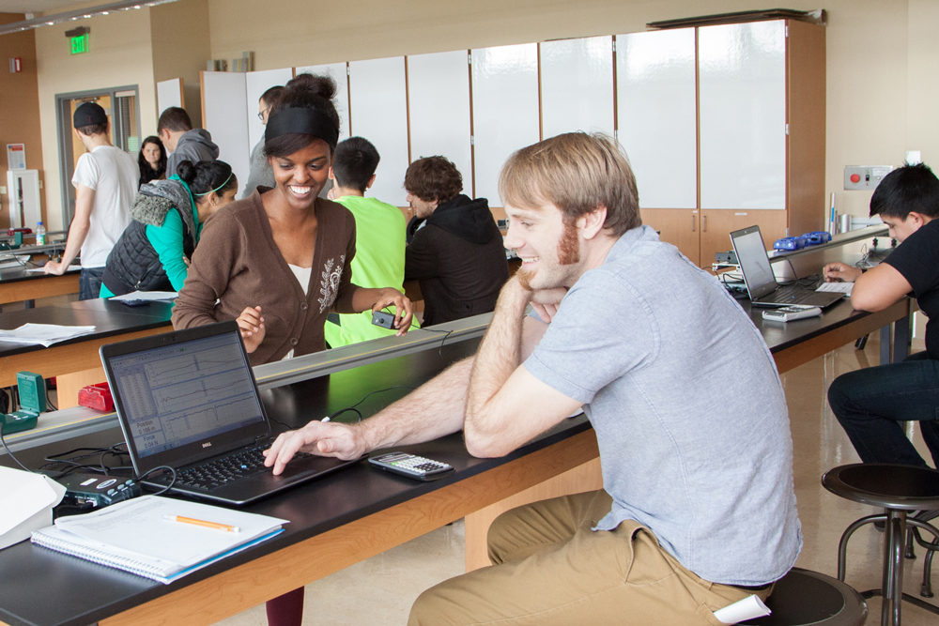
Learning by doing
VS

Slide 4
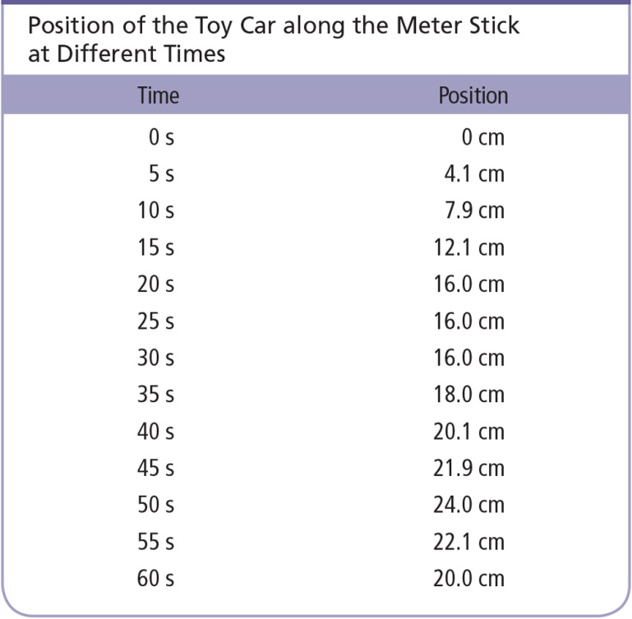
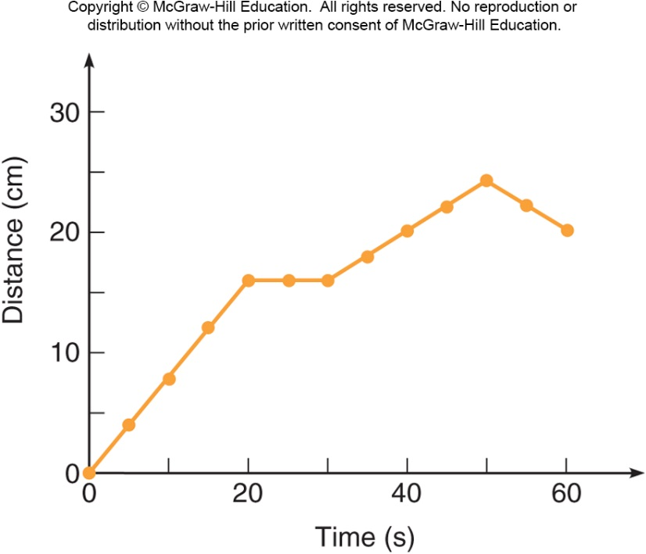
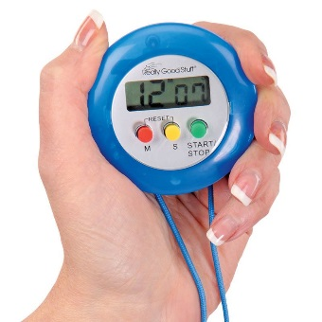
Data collection by hand

Slide 5
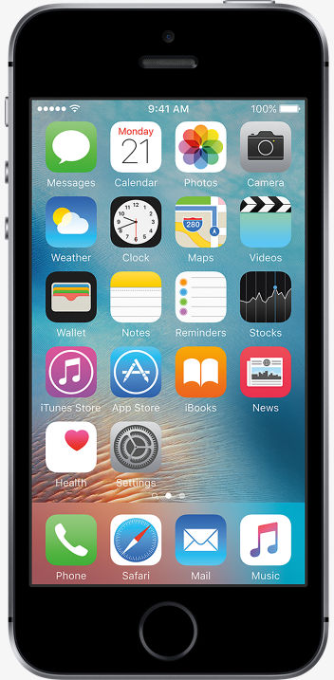
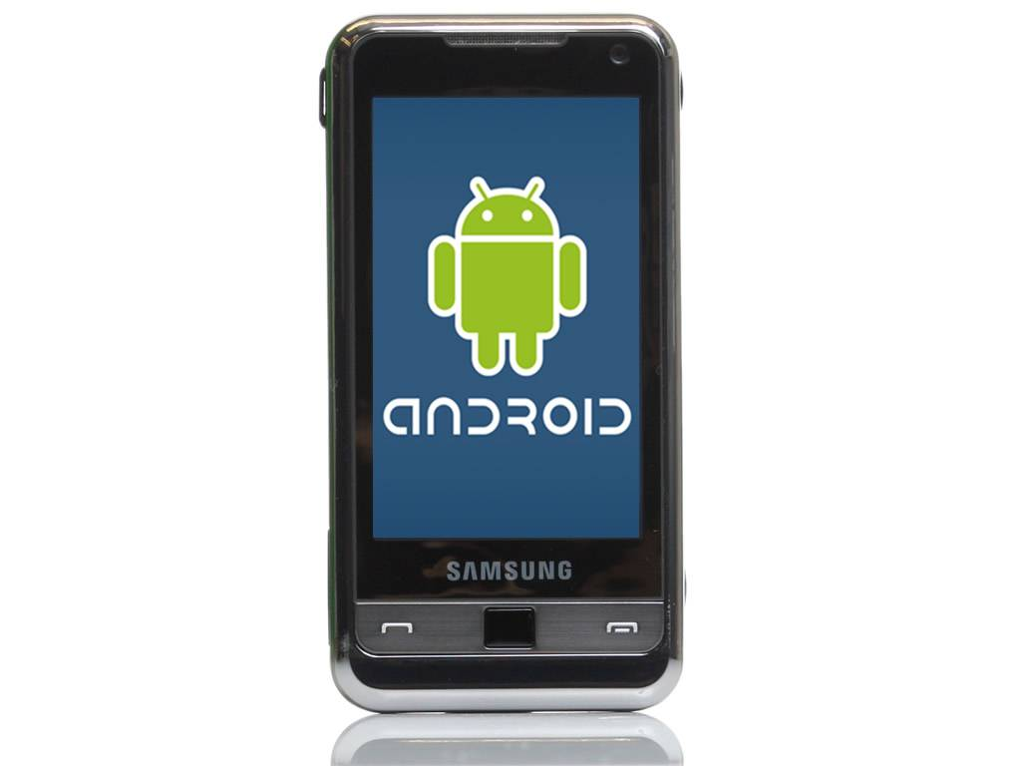
Smart Phones

Slide 6
Tracker-Video Analysis and Modeling Tool
Tracker is a FREE video analysis and modeling tool built on the Open Source Physics (OSP) Java framework. It is designed to be used in physics education.

Slide 7
my example

Slide 9
applications
What are some applications you can see for your classroom setting?

Slide 10
Your turn
Find a partner and make your own motion diagram.

